Slide 1
Lecture 31
Risk Management

Slide 2
Introduction
Information security departments are created primarily to manage IT risk
Managing risk is one of the key responsibilities of every manager within the organization
In any well-developed risk management program, two formal processes are at work
  Risk identification and assessment
  Risk control

Slide 3
Risk Management
“If you know the enemy and know yourself, you need not fear the result of a hundred battles
If you know yourself but not the enemy, for every victory gained you will also suffer a defeat
If you know neither the enemy nor yourself, you will succumb in every battle”
-- Sun Tzu

Slide 4
Knowing Yourself
Identifying, examining and understanding the information and how it is processed, stored, and transmitted
Armed with this knowledge, one can initiate an in-depth risk management program
Risk management is a process
  Safeguards and controls that are devised and implemented are not install-and-forget devices

Slide 5
Knowing the Enemy
Identifying, examining, and understanding the threats facing the organization’s information assets
  Must fully identify those threats that pose risks to the organization and the security of its information assets
Risk management
  The process of assessing the risks to an organization’s information and determining how those risks can be controlled or mitigated

Slide 6
Accountability for Risk Management
Communities of interest must work together
  Evaluating the risk controls
  Determining which control options are cost-effective
  Acquiring or installing the appropriate controls
  Overseeing processes to ensure that the controls remain effective
  Identifying risks
  Assessing risks
  Summarizing the findings

Slide 7
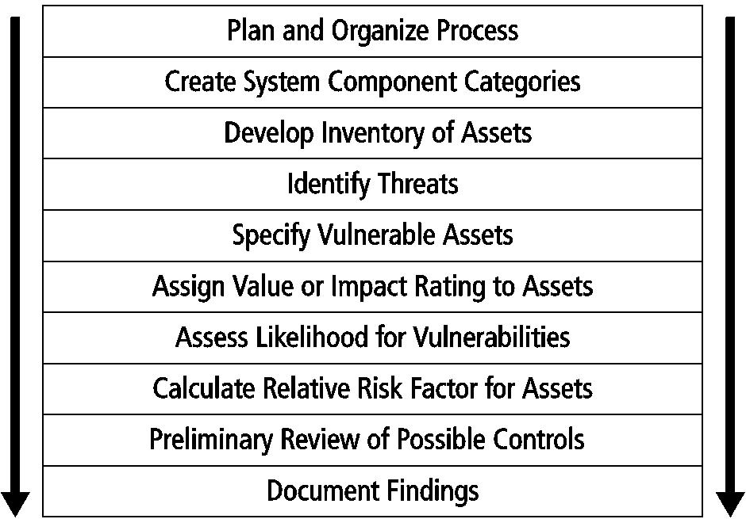
Risk Identification

Slide 8
Risk Identification (cont’d.)
Risk identification begins with the process of self-examination
  Managers identify the organization’s information assets
    Classify them into useful groups
    Prioritize them by their overall importance

Slide 9
Creating an Inventory of Information Assets
Identify information assets
  Includes people, procedures, data and information, software, hardware, and networking elements
  This step should be done without pre-judging the value of each asset
    Values will be assigned later in the process

Slide 10
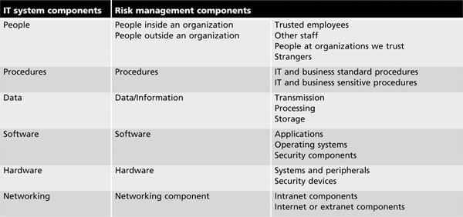
Creating an Inventory of Information Assets (cont’d.)

Slide 11
Creating an Inventory of Information Assets (cont’d.)
Inventory process requires a certain amount of planning
  Whether automated or manual
Determine which attributes of each information asset should be tracked
  Depends on the needs of the organization and its risk management efforts

Slide 12
Creating an Inventory of Information Assets (cont’d.)
Potential asset attributes
  Name, IP address
  MAC address, asset type
  Serial number, manufacturer name
  Manufacturer’s model or part number
  Software version, update revision, or FCO number
  Physical location, logical location
  Controlling entity

Slide 13
Creating an Inventory of Information Assets (cont’d.)
Identifying people, procedures and data assets
  Responsibility for identifying, describing, and evaluating these information assets should be assigned to managers who possess the needed knowledge, experience, and judgment
  As these assets are identified, they should be recorded using a reliable data-handling process like the one used for hardware and software

Slide 14
Creating an Inventory of Information Assets (cont’d.)
Sample attributes for people, procedures, and data assets
  People
    Position name/number/ID
    Supervisor name/number/ID
    Security clearance level
    Special skills
  Procedures
    Description
    Intended purpose

Slide 15
Creating an Inventory of Information Assets (cont’d.)
Sample attributes for people, procedures, and data assets (cont’d.)
  Procedures (cont’d.)
    Software/hardware/networking elements to which it is tied
    Location where it is stored for reference
    Location where it is stored for update purposes
  Data
    Classification
    Owner/creator/manager
    Size of data structure

Slide 16
Creating an Inventory of Information Assets (cont’d.)
Sample attributes for people, procedures, and data assets (cont’d.)
  Data (cont’d.)
    Data structure used
    Online or offline
    Location
    Backup procedures

Slide 17
Classifying and Categorizing Assets
Determine whether the asset categories are meaningful
Inventory should also reflect each asset’s sensitivity and security priority
  A classification scheme categorizes information assets based on their sensitivity and security needs
  Each of these categories designates the level of protection needed for a particular information asset

Slide 18
Classifying and Categorizing Assets (cont’d.)
Some asset types, such as personnel, may require an alternative classification scheme that would identify the clearance needed to use the asset type
Classification categories must be comprehensive and mutually exclusive

Slide 19
Assessing Values for Information Assets
Assign a relative value:
  As each information asset is identified, categorized, and classified
  Comparative judgments made to ensure that the most valuable information assets are given the highest priority
Relevant questions
  Which asset is the most critical to the success of the organization?

Slide 20
Assessing Values for Information Assets
Relevant questions (cont’d.)
  Which asset generates the most revenue?
  Which asset generates the highest profitability?
  Which asset is the most expensive to replace?
  Which asset is the most expensive to protect?
  Which asset’s loss or compromise would be the most embarrassing or cause the greatest liability?

Slide 21
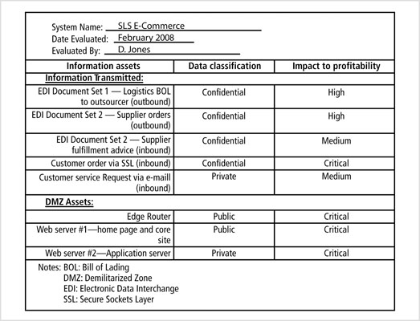
Source: Course Technology/Cengage Learning

Slide 22
Listing Assets in Order of Importance
The final step in the risk identification process is to list the assets in order of importance
This goal can be achieved by using a weighted factor analysis worksheet

Slide 23
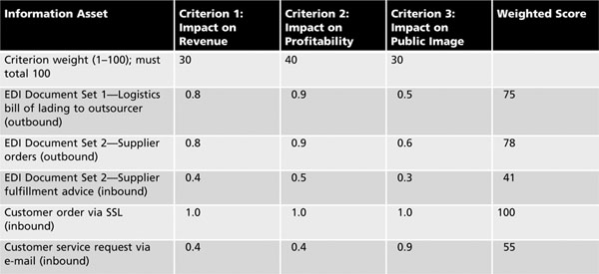
Listing Assets in Order of Importance (cont’d.)
Source: Course Technology/Cengage Learning

Slide 24
Threat Identification
Any organization typically faces a wide variety of threats
If you assume that every threat can and will attack every information asset
  The project scope becomes too complex
To make the process less unwieldy, each step in the threat identification and vulnerability identification processes is managed separately and then coordinated at the end

Slide 25
Threat Identification (cont’d.)
Each threat presents a unique challenge to information security
  Must be handled with specific controls that directly address the particular threat and the threat agent’s attack strategy
Before threats can be assessed in the risk identification process
  Each must be further examined to determine its potential to affect the targeted information asset
    This process is a threat assessment

Slide 26
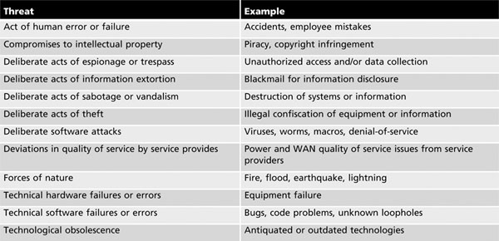
Threat Identification (cont’d.)
Source: ©2003 ACM, inc., included here by permission

